Slide 1


Single European Electricity Market - the Role of RES-E
Petr Spodniak
Beata Garšicová
Wolfgang Pichler

Slide 2


Agenda
Introduction
  Motivation
  Problem statement
  Approach
Results
  the European Union
  Finland
  the Czech Republic
  Austria
Discussion
Conclusion
Notes:
Picture: Lappeenranta University of Technology, Green Campus, 2012.

Slide 3
Motivation
process of market liberalisation and deregulation since 1990
major drivers: efficiency, lower prices for end consumers, new services
challenging goal (fully liberalized common electricity market by 2014)
role of RES

Slide 4
Problem Statement
implementation of 2009/72/EC Directive
obstacles: transmission capacities, non-discriminatory network access, regulatory supervision in each Member State,...
renewable energy support schemes
Finish, Czech & Austrian market

Slide 5
Approach
governance
  competition/coordination
technology dimension
  large scale centralized/ small scale decentralized systems
RES policy support mechanisms
EU vs. Finish, Czech & Austrian approach

Slide 6
Agenda
Introduction
  Motivation
  Problem statement
  Approach
Results
  the European Union
  Finland
  the Czech Republic
  Austria
Discussion
Conclusion
Notes:
Picture: Lappeenranta University of Technology, Green Campus, 2012.

Slide 7
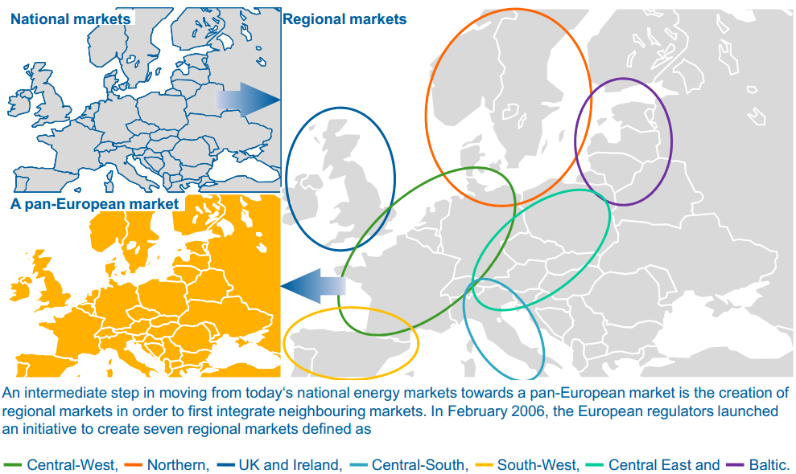
The EU - Electricity Market
Source: EMCC, The European Market, 2012
Notes:
The European Market [Online] / auth. EMCC // Creating Regional Markets. - May 2012. - March 22, 2012. - http://www.marketcoupling.com/market-coupling/european-market.

Slide 8
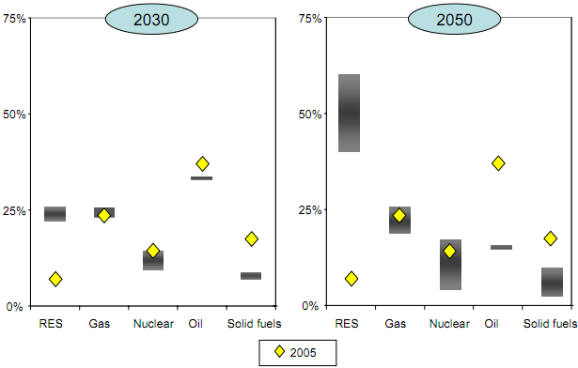
The EU - Renewable Energy
Source: European Commission, Energy Roadmap 2050, COM(2011) 885/2
Notes:
EU Decarbonisation scenarios - 2030 and 2050 range of fuel shares in primary energy consumption compared with 2005 outcome (in %)

Slide 9



Finland - Electricity Market
Nordic electricity market (SE, NO, DK, EE)
Unbundled 1995, fully opened 1998
Nord Pool Spot (physical), Nasdaq OMX Commodities (financial)
Generating companies (120), power plants (550), Fortum (40%), Pohjolan Voima (25%)
Energy deficit country (peak load 14588 MW, 13360 MW generation capacity, 2010)
Notes:
Pictures: Company logos

Slide 10
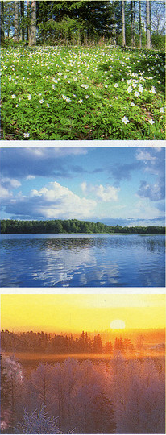
Finland – Renewable Energy
Long-term Climate and Energy Strategy (38% RES by 2020)
National renewable energy action plan (NREAP) – halt and reverse growth in final energy consumption
National energy efficiency plan (NEEP-2) - save 37 TWh of energy end-use by 2020
Act on Production Subsidy for Electricity Produced from Renewable Energy Sources (1396/2010)
Notes:
Picture source: WWF, Finland Suomi, http://www.flickr.com/photos/purple_rache/143409683/

Slide 11
The Czech Republic - Electricity Market
CZ – SK– (HU) market
3rd regulation phase (2010-2014)
Liberalized (2005), Unbundled 2006
Energy Regulatory Office, trading licenses (5Y)
Power exchange central Europe (PXE) – physical, financial settlement
Energy surplus country

Slide 12
The Czech Republic – Renewable Energy
Law about supported sources of energy (180/2005 Sb.)
European directive (2009/28/ES).
Long-term Climate and Energy Strategy (13% RES by 2020, 20% for EU)
Decrease of RES support by 2014
Ecological taxes (derogation till 2020)

Slide 13
Austria – Electricity Market
10 years of electricity market liberalization
Connected to German counterpart without border congestion
  Arbitrage-free area with one price
  Austrian producers hardly influence price on the EPEX Spot and EEX
  Austrian EXAA and EPEX prices highly correlate
  Trade of both hourly and block products on the Austrian EXAA was equivalent to 7.1% of demand
  OTC trade three times as high as exchanged turnover in 2009
Market concentration
  Four biggest producers add up to 80% of total capacity
  Cumulative market shares of three biggest suppliers for HH, small- and medium-sized enterprises: 60%
  HHI and RSI indicate a market concentration
Ownership structure
  Most companies are owned by provincial governments and local authorities (network distributers and utilities)
  Overlapping competence in regard to ownership and legislation
  Cross-holding character
HHI-Herfindahl-Hirschmann Index; RSI - Residual Supply Index, OTC - over the counter

Slide 14
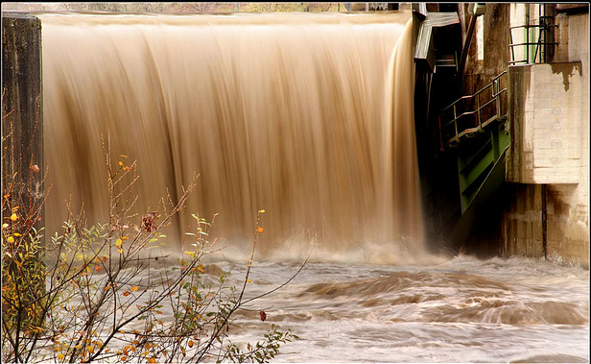
Austria – Renewable Energy
10% of green power contribution to total supply
  Including large hydro: 72% (2010)
Promotion scheme
  Feed-in-tariffs dependent on primary energy source, efficiency and load of power plant
  Average support in 2010 ranged from 7 cent/kWh to 53 cent/kWh ≈ 10 cent/kWh for green power
  Investment grants for (small) hydropower, plants using waste liquor and photovoltaics (>5kWp)
Funding
  Flat tax per meter dependent on the consumer’s position in the various network level
  Consumption tax per kWh of RES-E used
Target
  70.6% share of RES-E by 2020
  given the steady increase in energy consumption → 96% increase in RES-E by 2020
Notes:
Picture source: nomenestomen, Austrian Hydro Power, http://www.flickr.com/photos/hkavallar/2987683032/

Slide 15
Agenda
Introduction
  Motivation
  Problem statement
  Approach
Results
  the European Union
  Finland
  the Czech Republic
  Austria
Discussion
Conclusion
Notes:
Picture: Lappeenranta University of Technology, Green Campus, 2012.

Slide 16
Assessment Matrix
CZ
FI
AU
Adopted from Finon et al., Challenges when electricity markets face the investment phase. 2004. - Vol. 32. - pp. 1355–1362.

Slide 17
Discussion- Finland
Large-scale centralized system
Market concentration (largest three generators 45-50% market share)
Coordinated governance by industry groups
Mankala model - electricity generation at cost price for its shareholders
  economies of scale
  Entry barriers (centralization, integration, transparency)

Slide 18
Discussion– the Czech Republic
Small-scaled decentralized
  Market concentration : production (30% from nuclear power plants)
    trade-off between stability and flexibility
  Market concentration : distribution (CEZ: 44,46%; E.ON: 19,62%; PRE: 11,14%) sharply decreasing
Coordinated governance
  Energy Regulatory Office

Slide 19
Discussion- Austria
Industry group coordination
  Market concentration: 80% of total installed capacity controlled by the biggest three producers
  Small group of power generators seek for the stabilization of system performance and electricity prices
  Large-scaled power plants outweigh small-sized green power plants

Slide 20
Agenda
Introduction
  Motivation
  Problem statement
  Approach
Results
  the European Union
  Finland
  the Czech Republic
  Austria
Discussion
Conclusion
Notes:
Picture: Lappeenranta University of Technology, Green Campus, 2012.

Slide 21
Conclusions
Differences in market structures and approaches towards single electricity market
Historical structure of electricity markets shapes the current and future trends
Centralization vs. decentralization & competition issues
Further research:
  country classification based on RES investment attractiveness
  role of formal and informal institutions in shaping the electricity markets

Slide 22
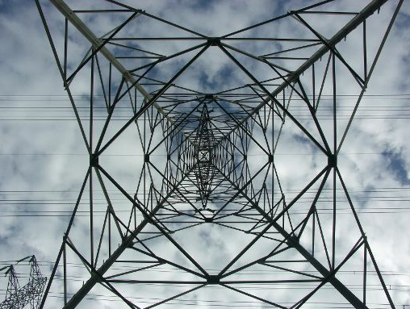
Thank You for listening!
Notes:
Picture source: European Parliament, 3rd Energy Package gets final approval from MEPs, 2009,
http://www.europarl.europa.eu/sides/getDoc.do?type=IM-PRESS&reference=20080616FCS31737&language=EN

Slide 23
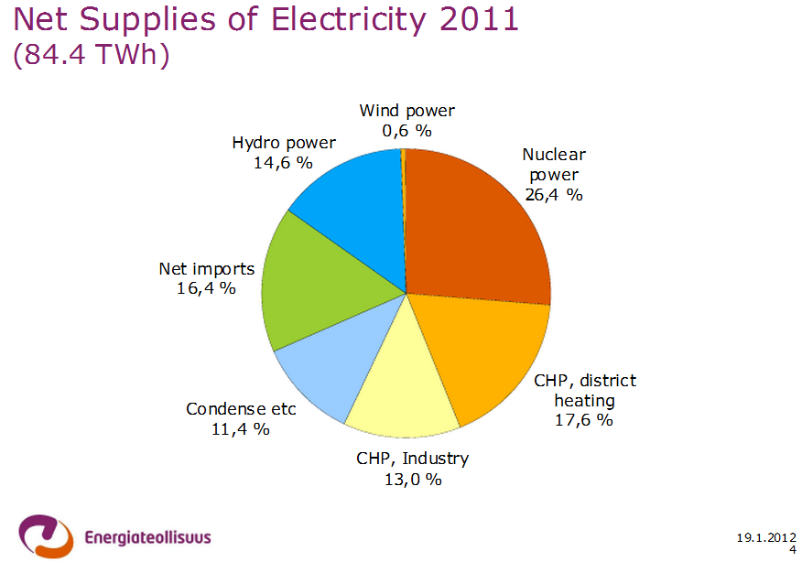
Appendix- Finland

Slide 24
Appendix: Marginal cost of production in the Nordic countries
Source: Keskikallio, Lindholm: The Nordic Electric Power market. Ministry of Trade and Industry Finland report 11/2003) in (EMV, 2011)

